Slide 1
Chapter 6
Infectious diseases and Immunity

Slide 2
Outline of the chapter
Infectious diseases
Infection and disease
Disease development and stages
Pathogenicity (primary and opportunistic pathogen)
Types of infectious diseases
Modes of transmission
Host defenses against infectious diseases

Slide 3
What are infectious diseases?
Infectious diseases are illnesses caused by harmful agents (pathogens) that get into the body. The most common causes are bacteria, viruses, fungi, protozoa, and helminthes.
Usually spread from person to person, through contaminated food, water and through bug bites
It occurs as a result of interactions between pathogenic microorganisms and the host
In order to cause infectious disease, a pathogen must accomplish the following steps
1. It must enter the host
2. It must metabolize and multiply on or in the host tissue
3. It must resist host defenses
4. It must damage the host
Infectious disease cause host damage by entering cell and directly causing cell death, releasing toxin that kill cell at a distance, releasing enzyme that degrade tissue components, damage blood vessels & etc.

Slide 4
Infection and disease
The terms "infection" and "disease" are not synonymous
An infection is the successful colonization of the host by a microorganisms.
It results when a pathogen enters and begins growing within the host
It can lead to disease, which causes signs and symptoms resulting in a deviation from the normal structure or functioning of the host.
Disease is any condition in which the normal structure or functions of the host body cells are damaged or impaired.
as a result of the infection and signs and symptoms of an illness appear

Slide 5
Signs and Symptoms of Disease
Sign
The signs of disease are objective and measurable, and can be directly observed by a clinician as a result of disease.
Vital signs which are used to measure the body’s basic functions. E.g. body temperature, heart rate, blood pressure, breathing rate and etc.
Changes in any of the body’s vital signs may be indicative of disease. E.g. having a fever
Observable conditions. E.g. the presence of antibodies in a patient’s serum
Symptoms
Symptom are subjective. A change in body function that is felt or experienced by the patient as a result of disease.
Examples of symptoms include nausea, loss of appetite, and pain.
Syndrome
A specific group of signs and symptoms that occur together and characterize a particular abnormality or condition.

Slide 6
Classification of infectious diseases
Number of criteria can be used to classify infectious diseases
1. Based on transmission potential
Communicable disease
a disease that can spread from one host to another. Some communicable disease is contagious meaning easily spread; it spreads through direct, bodily contact with an infected person, their discharges, or an object or surface they've contaminated.
the degree to which a disease is contagious usually depends on how the pathogen is transmitted
E.g. Measles, Influenza, Salmonella and etc.
Non-communicable disease
Aren’t caused by microorganisms, but by genetics, anatomical differences, getting older and the environment you live in.
a disease that is not transmitted from one host to another
E.g. Cancer, diabetes, congestive heart failure and Alzheimer’s disease

Slide 7
Cont’d
2. Based on occurrence/based on a disease's rate of spread
A variety of terms are used to describe the occurrence of an infectious disease within a specific geographic area or population.
Sporadic disease
disease that occurs occasionally and unpredictably in a population
Endemic disease
when disease is consistently present but limited to a particular region
E.g. Malaria considered endemic in certain countries and regions.
Epidemic disease
an unexpected increase in the number of disease cases in a specific geographical area.
disease acquired by many hosts in a given area in a short time
Pandemic disease
when a disease’s growth is exponential, affecting several countries and populations; worldwide epidemic

Slide 8


Measures of disease frequency: prevalence and incidence
Prevalence
fraction of a population having a specific disease at a given time
number of existing cases
$Prevalence=\frac{number of people in sample with characteristics }{total number of people in the sample}$x 100
E.g. In a population of 10,000 people, 500 persons are reported to be affected by a certain disease. So what is the prevalence of this disease in this population?
Incidence
fraction of a population that contracts a disease during a specific time
number of new cases of a disease or disorder

Slide 9
Cont’d
3. Severity or duration of infectious disease
The duration of the period of illness can vary greatly depending on the pathogen, effectiveness of the immune response in the host, and any medical treatment received.
Acute
Pathologic changes occur over a relatively short time (e.g., hours, days, or a few weeks) and involve a rapid onset of disease conditions.
E.g. Influenza (the incubation period is approximately 1–2 days)
Chronic
Pathologic changes can occur over longer time spans (e.g., months, years, or a lifetime)
E.g. chronic gastritis caused by Helicobacter pylori.

Slide 10
Cont’d
Subacute
symptoms appear between acute and chronic
Latent
The causal pathogen goes dormant for extended periods of time with no active replication
Period of no symptoms when the causative agent is inactive
E.g. herpes simplex viruses evade the host immune system by residing in a latent form within cells of the nervous system for long periods of time,
but they can reactivate to become active infections during times of stress and immunosuppression.

Slide 11
Cont’d
4. Extent of infection in the host
1. Local infection
Pathogens are limited to a small area of the body
2. Systemic infection
An infection throughout the body by blood and/or lymph
Bacteremia: presence of bacteria in the blood
Septicemia: presence and growth of bacteria in the blood
Toxemia: toxins in the blood
Viremia: viruses in the blood
3. Focal infection
Systemic infection that began as a local infection and moves via blood or lymph to set up a new infection at another site
tooth infection

Slide 12
Cont’d
5. Pathogenicity
Pathogenicity is the ability of a microbial agent to cause disease. Pathogens can be classified as either primary pathogens or opportunistic pathogens.
Primary pathogen
A primary pathogen can cause disease in a host regardless of the host’s resident microbiota or immune system.
Microbe or virus that causes disease in healthy individual
Opportunistic pathogen (opportunist)
Can only cause disease in situations that compromise the host’s defenses, such as the body’s protective barriers, immune system, or normal microbiota.

Slide 13
Laboratory Diagnosing Infectious Disease
Diagnosing is identifying the causative agent of disease. The following are methods of diagnosing infectious disease.
Microscopy and in vitro culture
Molecular diagnosis- molecular techniques such as nucleic acid sequencing and protein analysis by mass spectrometry are rapidly replacing traditional methods
Serologic diagnosis- immunologic techniques are used to detect, identify, and quantitate antigen in clinical samples.
The specificity of the antibody-antigen interaction and the sensitivity of many of the immunologic techniques make them powerful laboratory tools

Slide 14
Stages of Pathogenesis
To cause disease, a pathogen must successfully achieve four steps or stages of pathogenesis: exposure (contact), adhesion (colonization), invasion, and infection.
Exposure (contact)
encountering with a potential pathogen. The food we eat and the objects we handle are all ways that we can come into contact with potential pathogens.
Adhesion (colonization)
following the initial exposure, the pathogen adheres at the portal of entry using adhesion factors.
E.g. Molecules (either proteins or carbohydrates) called adhesins are found on the surface of certain pathogens and bind to specific receptors (glycoproteins) on host cells.
Adhesins are present on the fimbriae and flagella of bacteria, the cilia of protozoa, and the capsids or membranes of viruses.

Slide 15
Cont’d
Invasion
Once adhesion is successful, invasion can proceed.
Invasion involves the dissemination of a pathogen throughout local tissues or the body.
Pathogens may produce exoenzymes or toxins, which serve as virulence factors that allow them to colonize and damage host tissues as they spread deeper into the body.
Infection
successful multiplication of the pathogen leads to infection.
Infections can be described as local, focal, or systemic, depending on the extent of the infection.

Slide 16
Disease development and stages
If the immune system is able to fight off the pathogen before it can establish an infection, no signs of disease will occur.
The infectious disease process is categorized into different stages of infection.
When someone contracts an acute infection, they will experience five stages of infection:
1. Incubation period
time interval between initial infection and first appearance of signs and symptoms. A person does not show any signs or symptoms of sickness.
2. Prodromal period
characterized by appearance of first mild signs and symptoms that signal onset of some diseases.
But the symptoms are mild and not very specific or diagnostic.

Slide 17
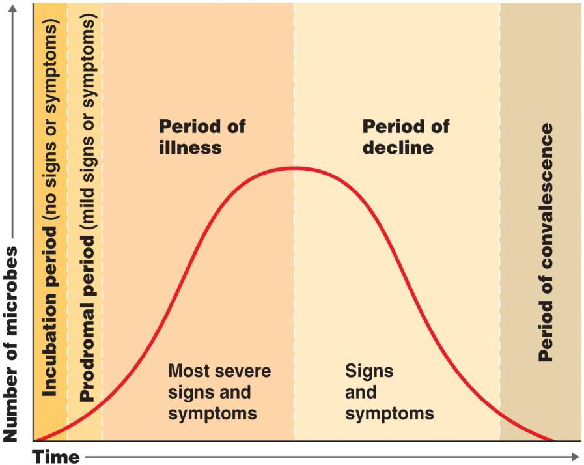
Cont’d
3. Period of illness
disease at its height, when it is highly contagious and person experiencing fulminant symptoms.
4. Period of decline
signs and symptoms subside, invading pathogens decrease in the body as the immune system combats the infection.
5. Period of convalescence
body returns to pre diseased state, health is restored, microbial replication has halted by immune system.

Slide 18
Causative agents of infectious disease
Pathogen is an infectious agent responsible for development of disease.
The common pathogens known as causative agents for different types of infectious diseases are:
bacteria, viruses, fungi, protozoa and helminths

Slide 19
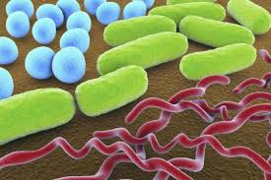
Bacteria
Are unicellular prokaryotic organisms reproduce by binary fission
Their cell walls are made from peptidoglycan
The three most common shapes of bacteria are:
Bacillus (rod-shaped), coccus (spherical), or spirillum (helical rods) Based on their cell wall structures, which influences their Gram stain reaction, bacteria can be:
Gram-negative
Appear pink after the staining procedure
Salmonella typhi : causes typhoid fever
Yersinia pestis: causes plague
2. Gram-positive bacteria
Appear purple after Gram staining procedure
Staphylococcus aureus
causes skin, respiratory and wound infections
Clostridium tetani
produces a toxin that can be lethal for humans

Slide 20
Bacterial association with the host
Some of them live inside the human body without causing harm (normal flora). E.g in mouth, intestine
have symbiotic relationship with the host
the host provides a place to colonize, nutrients,
while the microbes stimulate innate immunity and prevent colonization with unwanted pathogens
Not all body organs harbor normal flora; some are free of any microbes. Eg. Kidney, heart, lung & etc
Some bacterial cause diseases like:
E.g. cholera, pneumonia, tuberculosis, typhoid, and etc.
Bacterial infections can be treated with antibiotics

Slide 21
Viruses
Are not living organisms because, unless occupying an appropriate living host cell cannot reproduce
They have no metabolic capability
All viruses are obligate intracellular parasites
They contain either DNA or RNA, but not both
They have no internal cellular structure

Slide 22
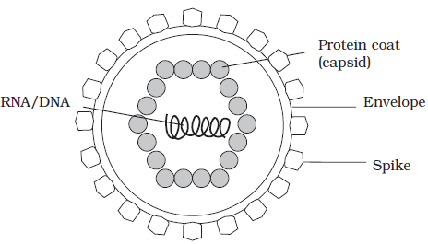
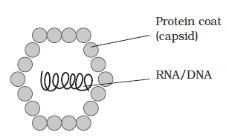
What viruses are composed of?
An intact viral particle, or virion, has in essence just two components: a core of nucleic acid, surrounded and protected by a protein coat or capsid.
Enveloped viruses- composed of nucleic acid DNA or RNA, capsid (protein) and an envelop)
E.g. HIV a retrovirus, Influenza virus,
SARS-CoV-2 virus
Non- enveloped viruses- composed of nucleic acid DNA or RNA and capsid.

Slide 23
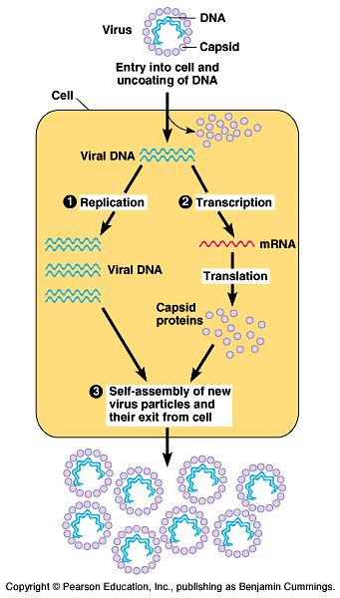
The general viral process of replication and infection
The new viruses can be released through either of the two situations
1. In some cases, virus-derived enzymes destroy the host cell membranes, killing the cell and releasing the new virus particles
2. In other cases, new virus particles exit the cell by a budding process, weakening but not destroying the cell
1. Viral particle first attaches to a specific host cell
2. The viral genome is then inserted into the host cell,
3. Replication, then
4. The new viruses are released from the host cell

Slide 24
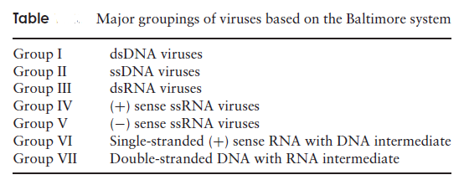
Cont’d
Single-stranded RNA viral genomes can be divided into two types: (+) sense and (−) sense RNA.
(+) sense is able to act as mRNA, attach to ribosomes and become translated into the relevant proteins within the host cell. As such, it is infectious in its own right.
(−) sense RNA is only infectious in the presence of a capsid protein possessing RNA polymerase activity. This is needed to convert the (−) RNA into its complementary (+) strand, which then acts as a template for protein production, as described above.

Slide 25
RNA viruses
Genetic material can be used directly as messenger RNA to produce viral proteins
RNA viruses that cause human disease include
rhinoviruses: cause most common colds
myxoviruses and paramyxoviruses that cause influenza, measles, and mumps
rotaviruses: cause gastroenteritis
Retroviruses, use a unique enzyme called reverse transcriptase to copy the RNA genome into DNA
This DNA then integrates itself into the host cell genome
E.g. the human immunodeficiency virus (HIV)

Slide 26
Cont’d
Viruses cause disease by disrupting normal cell function. They do this in a variety of ways
Some viruses make repressor proteins that stop the synthesis of the host cell's proteins, RNA and DNA
2. Some viruses change the function of the host cell
E.g. human papillomavirus can lead to cancer by forcing cells to replicate in an uncontrolled way
3. Viral activity may weakens cell membranes and lysosomal membranes, leading to cell autolysis
Antiviral medications help in some cases
They can either prevent the virus from reproducing or boost the host's immune system

Slide 27
Fungi
Fungi are eukaryotic, heterotrophic organisms that have cell walls made from chitin
Reproduce primarily by forming spores
Most fungi are multicellular (such as moulds have long, branched, threadlike filaments called hyphae, which aggregate together to forma tangled mycelium), although some, such as yeasts, are non-flamentous unicellular
Most fungi are saprobic- they obtain their nutrients from decaying matter by secreting enzymes extracellularly to break down complex molecules

Slide 28
Fungi cont’d
They are of great importance economically and may have beneficial effects (e.g. the production of bread and alcohol, cheese making process, antibiotic production & etc) or
Detrimental effects (e.g. destroy materials, some fungi may cause disease; huge damage is caused to crops and other commercially valuable plants, while a number of human diseases, particularly of the skin and scalp are also caused by fungi. ).
Many fungi are dimorphic, they exist in two distinct forms. Some fungi that cause human infections can change from the yeast form in the human to a mycelial form in the environment in response to changes in nutrients, and environmental factors such as CO₂ concentration and temperature.

Slide 29
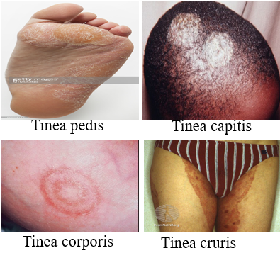
Fungi cont’d
A limited number of fungi are pathogenic to humans. Mycoses is diseases caused by fungi to humans and animals. Mycoses in humans may be cutaneous, or systemic.
Cutaneous mycoses- caused by fungi known as dermatophytes
Utilize the keratin of skin, hair or nails
by secreting the enzyme keratinase.
E.g. ringworm and athletes’ foot
Systemic mycoses- infections deep within the body
spores generally enter the body by inhalation, but subsequently spread to other organ systems via the blood, causing serious, even fatal disease.
much more serious, and include conditions such as histoplasmosis and blastomycosis.

Slide 30
Protozoa
Unicellular, heterotrophic eukaryotes (typically ingesting articulate food such as bacteria, and digesting them in phagocytic vacuoles) that include amoeba and paramecium
Morphologically there are diverse group, lack cell walls
Majority of them are free-living, the group also includes commensal forms and some parasites of animals and humans.
Have contractile vacuole- to pump out excess amounts of water that enter the cell by osmosis
The structural features used to achieve locomotion (e.g. cilia, flagella) are among the characteristics used to classify the protozoans.
Can be acquired through
Contaminated food or water
Bite of an infected arthropod E.g. Malaria

Slide 31
Group of protozoans are
Zooflagellates- characterized by the long flagellum. May be free-living, symbiotic or parasitic.
Parasitic zoofalgellates (E.g. Trypanosoma brucei- the causative agent of African sleeping sickness in humans; Giardia lamblia, the causative agent of the intestinal disease giardiasis).
The ciliates (Ciliophora)- Most are free-living types such as paramecium
The only ciliate known to cause disease in humans is Balantidium coli, which causes a form of dysentery.
The amoebas (Sarcodina)- characterized by the possession of pseudopodia
Most amoebas are free-living in aquatic environments however, are some important parasites, including Entamoeba histolytica, which causes amoebic dysentery in human.
The sporozoans (Apicomplexa)- characterized by a spore-like stage called a sporozoite
Are all parasitic, infecting a range of vertebrates and invertebrates.
E.g. Plasmodium, the causative agent of malaria

Slide 32
Helminths
Helminths are worm-like parasites
Simple, invertebrate characterized by elongated, flat or round body. Some of them are infectious parasites
They are multicellular and have differentiated tissues
Human helminthic infections can be acquired through consumption of food products from infected animals and plants, drinking contaminated water and etc,
Their physiology is similar in some ways to human
This makes parasitic helminth infections difficult to treat because drugs that kill helminths are frequently very toxic to human cells
Many helminths have complex reproductive cycles that include multiple stages, many or all of which require a host
The common helminthes are ascaries, tape worm, hook worm, schistosoma & etc.

Slide 33
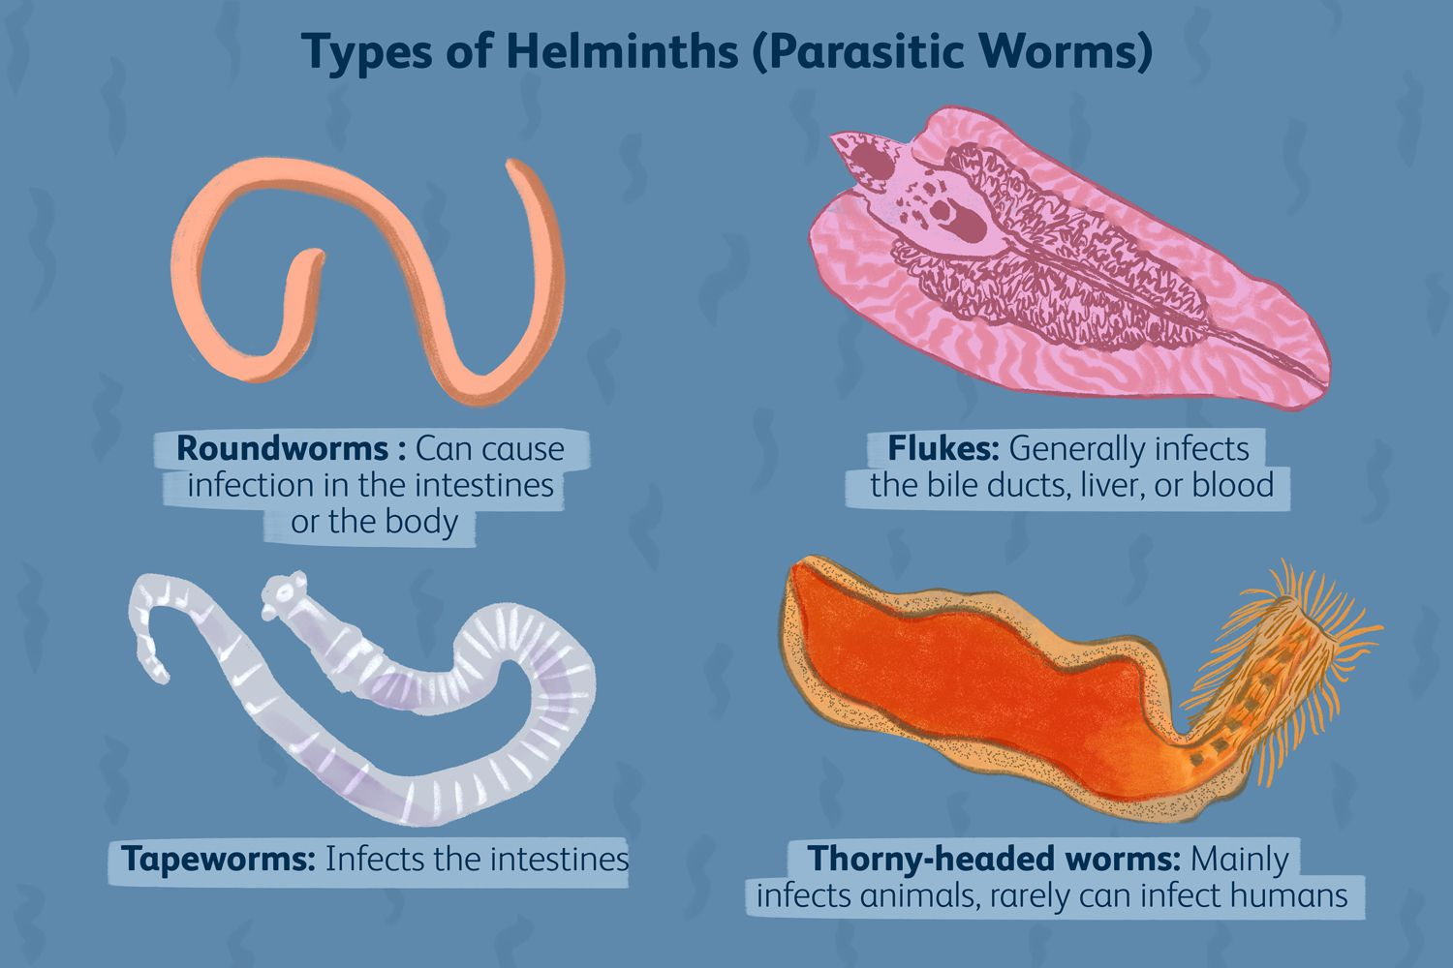
Helminths cont’d
Classification is based on the external and internal morphology of egg, larval and adult stages.
Flukes (Trematodes)- adult flukes are leaf-shaped flatworms. Are hermaphroditic except for blood flukes, which are bisexual. The life-cycle includes a snail intermediate host.
Tapeworms (Cestodes)-adult tapeworms are elongated, segmented, hermaphroditic flatworms that inhabit the intestinal lumen.
Roundworms (Nematodes)- adult and larval roundworms are bisexual, cylindrical worms. They inhabit intestinal and extra-intestinal sites.

Slide 34
Prions
Prion is protein that contains no genetic material
do not replicate or feed on the host but trigger abnormal behavior in the body's cells and proteins
Cause disease in humans and animals by triggering normally healthy proteins in the brain to fold abnormally.
Once a misfolded prion enters a healthy person potentially by eating infected food, it converts correctly folded proteins into the disease associated form.

Slide 35
Cont’d
The known prion diseases include
Creutzfeldt-Jakob disease (in humans)- fatal neurodegenerative disease of the brain
scrapie (in sheep) and
bovine spongiform encephalopathy ("mad cow disease" in cattle)-neurodegenerative disease
Mode of transmission can be:
inherited
infection from
eating infected tissue or
medical procedures such as tissue transplants

Slide 36
Modes of transmission
Communicable disease are transmitted from source of infection to susceptible individual in many different ways depending on infectious agent, portals of entry, and local ecological condition.
Mode of transmission may be classified as:
Direct transmission | Indirect transmission
Direct contact | Vehicle borne
Droplet infection | Vector borne ( mechanical & biological)
Contact with soil | Air borne
Inoculation into skin | Fomite borne
Trans-placental (vertical) | Unclean hands and fingers

Slide 37
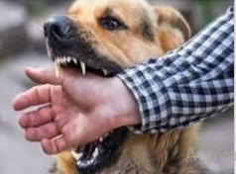
Direct transmission
Direct contact- transmitted direct contact from skin to skin and etc.
E.g. AIDS, leprosy, skin infection
Droplet infection- direct projection of a spray of droplets of saliva and nasopharyngeal secretion during coughing, sneezing…
E.g. common cold, TB, whooping cough
Contact with soil- direct exposure of susceptible tissue to the disease agent in the soil.
E.g. hookworm larvae, tetanus
Inoculation into the skin or mucosa-
disease agent may be inoculated directly
into the skin. E.g. Rabies
Transplacental or vertical
Transmission of disease from parent to child during reproduction and fetal development
E.g. herpes encephalitis (which occurs when an infant contracts the herpes simplex type II virus during birth)

Slide 38
Indirect transmission
Occurs when a pathogen can withstand the environment outside its host for a long period of time before infecting another individual.
Vehicle borne- transmission through water, food, blood, plasma…
E.g. water & food borne- typhoid fever, cholera, hepatitis A
Vector borne- (mechanical vector and biological vector)
Air borne- float in the air and disseminated by air currents from the point of their origin.
Fomite borne- inanimated substances such as clothes, towels, books other than water or food.
Unclean hands and fingers- common medium by which pathogens are transferred to food from d/t sources

Slide 39
What are the parts of immune system?
Our immune system is made of up a complex collection of cells and organs.
White blood cells
Lymph nodes:- contain immune cells that analyze the foreign invaders brought into body,
Spleen:-store white blood cells,
Tonsils and adenoids:- can trap foreign invaders as soon as they enter the body,
Thymus:- helps mature a certain type of white blood cell,
Bone marrow:- makes new blood cells and releases them into blood stream,
Skin, mucous membranes and other first-line defenses
Stomach and bowel:- stomach acid kills many bacteria soon after they enter your body.

Slide 40
Host defenses against infectious diseases
What is the Immune System?
Immune System is a large network of organs, white blood cells, proteins (antibodies) and chemicals which works together to protect us from foreign invaders.
Set of cellular and humoral components
Function: to keep germs out of our body, destroy them or limit the extent of their harm if they get in.
Immunity is the ability to ward off damage or disease
Immune system has two lines of defense against pathogens
Innate and
Adaptive, both divided into cell mediated defense and humoral defense factors
These two systems work together in order to destroy invaders or to trigger defense processes

Slide 41
Cont’d
Since we live in microbial world, our bodies are constantly being exposed microbes and must restrict the normal flora from entering into sterile tissue sites.
The initial defense mechanisms are barriers such as the skin, acid and bile of the gastrointestinal tract, and mucus that inactivate and prevent entry of the foreign agents
If these barriers are compromised or the agent gains entry in another way, then the innate responses must quickly rally to the challenge and prevent expansion of the invasion.
The innate responses then activate a major campaign specifically directed against the invader by antigen specific immune responses (B cells, antibody, and T cells).

Slide 42
Innate Immune system
Comprises cells and mechanisms that defend the host from infection by other organisms in a non-specific manner
designed to prevent microbes from entering the body and to help eliminate those that do gain access
Have the following characteristics
Faster
Non-specific
No memory component developed/retains no memory of previous infection
Duration of the immune response is over a short period

Slide 43
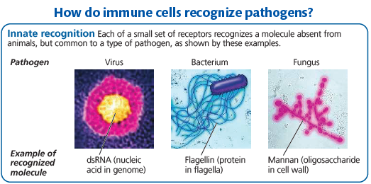
cont’d
Innate immune system commonly divided into four compartments
Mechanical barriers
Humoral parameters
Cellular components
Fever and inflammation

Slide 44
1. Mechanical Barriers
Skin and mucous membranes
provide both physical and chemical barriers that discourage pathogens from penetrating the body and causing disease
Skin- epidermis of skin provides a formidable physical barrier to the entrance of microbes
Mucous membranes- the epithelial layer of mucous membranes secretes a fluid called mucus which traps many microbes and foreign substances
the mucous membrane of nose has mucus-coated hairs
upper respiratory tract contains cilia to trap and filter microbes, dust, and pollutants from inhaled air
coughing and sneezing accelerate movement of mucus and its entrapped pathogens out of the body

Slide 45
2. Humoral component (chemical barriers)
Contains a variety of proteins capable of destroying or inhibiting growth of infectious microorganisms, which include:
Lysozyme
Acts on the peptidoglycan of pathogens cell wall
Complement system proteins
Comprised of soluble and membrane proteins that destroy pathogens through membrane injuries
Interferons- interfere with viral replication
Anti-proteases- against microorganism proteolytic proteins
C-reactive protein
promoting pathogen opsonization, complement activation and phagocytosis

Slide 46
3. Cellular components
Phagocytes- specialized cells that perform phagocytosis
The two major types of phagocytic cells in mammalian body
Neutrophils (circulate in the blood, are attracted by signals from infected tissues and then engulf and destroy the infecting pathogens) and
Macrophages (“big eaters”)-phagocytosing foreign antigens such as bacteria.
In addition to these cells, a number of more specialized cell types also contribute to innate immune defenses:
Dendritic cells mainly populate tissues, such as skin, that contact the environment.
They stimulate adaptive immunity against pathogens that they engulf.

Slide 47
Cellular components cont’d
Eosinophils- often found beneath an epithelium, are important in defending against multicellular invaders, such as parasitic worms.
Upon encountering such parasites, eosinophils discharge destructive enzymes.
Natural killer cells- circulate through the body, detect the abnormal surface proteins found on some virus-infected and cancerous cells.
Do not engulf stricken cells. Release chemicals that lead to cell death, inhibiting spread of the virus or cancer.
Immune cells present in blood, spleen, lymph nodes, and bone marrow
Mast cells- are found in connective tissue and make key contributions to the inflammatory response as well as to allergies.

Slide 48
4. Fever and Inflammation
Fever is an inflammatory response results in overall increase in body temperature.
Enhances innate immune defenses by stimulates leukocytes and rise in body temperature may inhibit growth of many pathogens.
It also reported that fever may stimulate the release of iron sequestering compound from the liver thereby starving out microbes that rely on iron for growth.

Slide 49
Cont’d
Inflammation- a local inflammatory response begins when activated macrophages discharge cytokines, signaling molecules that recruit neutrophils to the site of injury or infection.
In addition, mast cells release the signaling molecule histamine at sites of damage.
Histamine triggers blood vessels to dilate and become more permeable. The resulting increase in local blood supply produces the redness and increased skin temperature typical of the inflammatory response.
During an inflammation dilation of blood vessels occurs to:
increase blood volume in affected areas
allow invasion of white blood cells into the affected area
Characterized by redness, swelling, fever, and pain

Slide 50
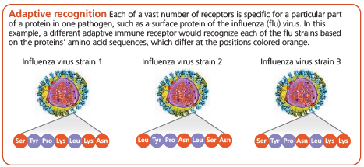
Adaptive immunity
When non-specific mechanisms fail, the body initiates a second, specific line of defense.
The adaptive immune response, also known as the acquired immune response, is activated after the innate immune response and develops more slowly
Have the following characteristics
Specific
for particular foreign molecules (antigens)
distinguish self from non-self molecules
Memory component developed
Duration of the immune response is over a long period (some times lifetime)

Slide 51
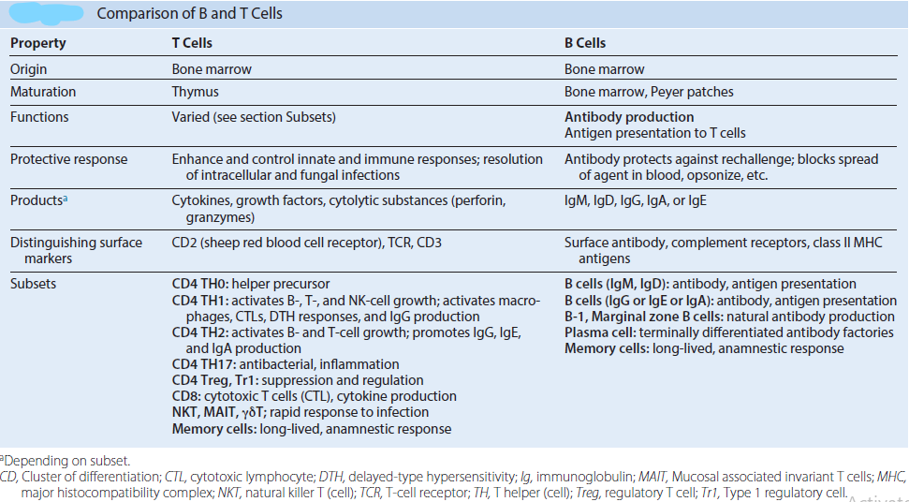
Cont’d
Adaptive immunity relies on T cells and B cells, which are types of white blood cells called lymphocytes

Slide 52
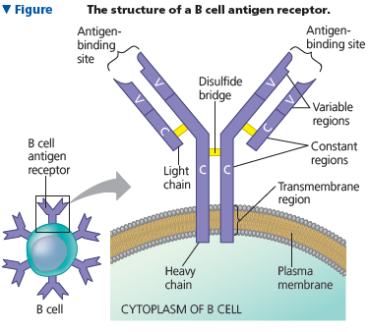
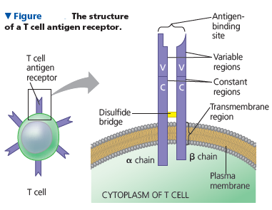
Any substance that elicits a B or T cell response is an antigen.
Recognition occurs when a B cell or T cell binds to an antigen, such as a bacterial or viral protein, via a protein called an antigen receptor.
Each antigen receptor binds to just one part of one molecule from a particular pathogen, such as a species of bacteria or strain of virus.

Slide 53
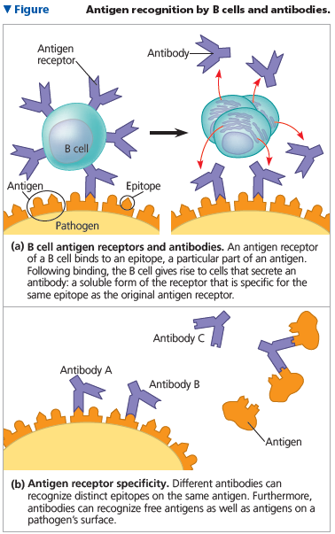

Slide 54
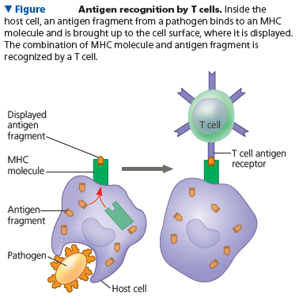
The host protein that displays the antigen fragment on the cell surface is called a major histocompatibility complex (MHC) molecule. By displaying antigen fragments, MHC molecules are essential for antigen recognition by T cells.
There are two major types of mature T-cells that exit the thymus
Helper T cells (CD4)- help the activation of cytotoxic T cells, B cells and other immune cells
Cytotoxic T cells (CD8)- responsible for removing pathogens and induce cell death (kill cell harboring pathogens

Slide 55
Components of adaptive immunity
The defenses provided by B and T lymphocytes can be divided into humoral and cell-mediated immune responses.
1. Humoral immune response
protects the blood and lymph (once called body humors, or fluids).
Primarily driven by B cells
In this response, antibodies help neutralize or eliminate toxins and pathogens in body fluids.
2. Cell-mediated immune response
Specialized T cells destroy infected host cells.
Unlike humoral immunity, does not depend on antibody.
Both humoral and cellular immunity can include a primary and a secondary immune response, with memory cells enabling the secondary response

Slide 56
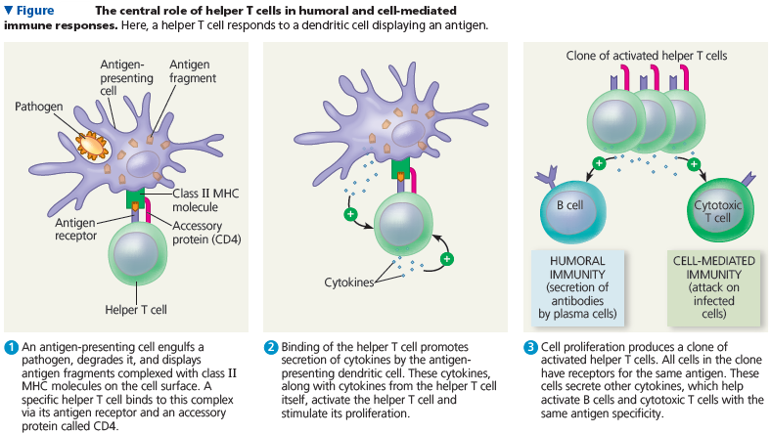

Slide 57
Cont’d
Both the cell-mediated and humoral mediated responses are initiated after macrophage engulfs a pathogen and then display antigens from the pathogen on their surface.
This display helps the macrophages stimulate specific helper T-cells to release signal molecules called lymphokines
Lymphokines are cytokines produced by T cells
The lymphokines, in turn, stimulate the cell-mediated and antibody-mediated responses

Slide 58
Cont’d
The humoral/antibody mediated response occurs when the lymphokines activate specific B-cells to produce antibodies
These antibodies attach to antigens on the surface of the pathogens and signal attack by phagocytic cells and complement system.
Other B-cells go on to become memory B-cells, which respond quickly by producing more antibodies upon subsequent infection.

Slide 59
Both innate immunity and adaptive immunity wok together
through direct contact with each other, and through interactions with chemical mediators, the cytokines.
cytokines are hormone-like proteins that act on cells to activate and regulate the innate immune response Examples
Macrophages are responsible to phagocytosis the infectious microbes and at the same time produce important cytokines that help to induce the adaptive immune response.
Complement components of the innate immune system can be activated directly by microbes, but can also be activated by antibodies, molecules of the adaptive system.

Slide 60
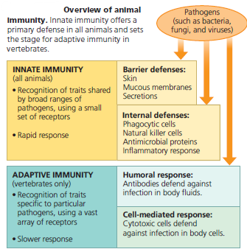

Slide 61
Immunological disorders
The aim of the immune responses is to protect the body from damage that may be caused by any environmental agents including pathogens.
However, sometimes adverse immunological reactions can occur and cause adverse effects to the host due to:
exaggerated immune response and/or producing inappropriate immune response against self-components
failure of appropriate recognition mechanism
In general, there are three types of immunological disorders
Hypersensitivity
Autoimmune diseases
Immunodeficiency

Slide 62
Hypersensitivity reactions
Hypersensitivity is an immunological state in which the immune system “over-reacts” to foreign antigen such that the immune response itself is more harmful than the antigen.
causes inappropriate and/or excessive tissue damage
Hypersensitivity reactions are responsible for many of the symptoms associated with microbial infections.
All types of hypersensitivity involves:
the adaptive immune response (highly specific reactions via T or B cells)
Prior exposure to the antigen, the initial exposure sensitizes the individual but does not cause a hypersensitive reaction
hypersensitivity is only seen on secondary exposure

Slide 63
Hypersensitivity reactions occur to people with an established immunity to the antigen. The mediator and the time course primarily distinguish the four types of hypersensitivity responses
Type I:
is caused by IgE and is associated with allergic, atopic, and anaphylactic reactions)
rapid-onset reactions (2-30 minutes)
Type II: cytotoxic reactions
cell damage due to complement activation via IgM or IgG
Type III: immune complex reactions
responses result from activation of complement by immune complexes
cell damage due to excess antibody/antigen complexes
Type IV: delayed cell-mediated reactions
T cells & macrophages mediated inflammatory response
Types I-III are all antibody-mediated, Type IV is cell-mediated responses.

Slide 64
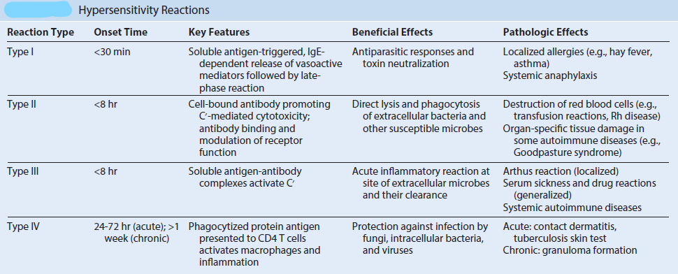

Slide 65
Autoimmune disorders
A condition that occurs when the immune system mistakenly attacks and destroys healthy body tissue.
immune system fails to recognize a protein as “self” and launches an attack
Autoimmune disorders are chronic and usually irreversible but drugs can help slow the progress of these diseases
Examples autoimmune disorders
Multiple sclerosis- a disorder in which the body's immune system attacks the protective covering of the nerve cells in the brain, optic nerve…
Lupus – inflammatory disease affect the joints, skin, kidneys, blood cells, brain, heart and lungs.
Rheumatoid arthritis- mainly affect joints

Slide 66
Immunodeficiency
Loss or inadequate function of various components of the immune system
It may result from genetic deficiencies, starvation, drug-induced immunosuppression (e.g., steroid treatment, cancer chemotherapy, chemotherapeutic suppression of tissue graft rejection), cancer (especially of immune cells), or disease (e.g., AIDS) and naturally occurs in neonates and pregnant women.
Deficiencies in specific protective responses put a patient at high risk for serious disease caused by infectious agent.
Can occur in any part of the immune system
physical barrier, phagocytes, B lymphocytes, T lymphocytes, complement, natural killer cells

Slide 67
Classified as primary or secondary immunodeficiency
1. Primary (congenital) immunodeficiency
Genetic abnormality caused by mutations affecting any of a large number of genes that control the expression and activities of immune responses
can affect either the lymphoid or the myeloid lineages
Defects in lymphoid lineage
involve B-cell, T-cell or both
B-Cell immunodeficiency, T-cell deficiencies
Defects in myeloid linage
affect innate immunity, especially phagocytic activity.
Chronic granulomatous disease (CGD)- genetic disorder in w/c phagocytes are unable to kill certain type of bacteria and fungi
Complement deficiencies
2. Secondary (Acquired) immunodeficiency
results from infections, nutritional deficiencies or treatments
E.g. AIDS, chronic leukemia

Slide 68
Reading Assignment
Tumor Immunology
Tumor immunology refers to the relationship between immune function and tumor cells
Immune surveillance is a concept that envisages prevention of the development of the most tumors through early destruction of abnormal cells by the host's immune system.

